Slide 1

Credit Card Default Analysis
Insights and Predictive Modeling

Slide 2
Problem Statement
This project focuses on predicting credit card default risk using data from April to September 2005, blending advanced statistical methods with deep analysis of demographic and credit data. Drawing from key predictive analytics techniques, it offers a rich exploration of credit behaviors and risk factors, leading to a predictive model that enhances decision-making for credit card companies. The approach includes rigorous data cleaning, exploratory analysis, and model evaluation. This work not only addresses immediate risk assessment needs but also sets a foundation for future advancements in the field.

Slide 3
Dataset Overview
Demographic Variables: Gender, education level, marital status.
Repayment Status: Monthly records from April to September.
Bill Amounts: Monthly statements for each account.
Previous Payments: Amounts paid by the account holder each month.
Credit Limit: Maximum credit allowed on the card.

Slide 4
Exploratory Data Analysis (EDA) Overview
EDA focused on understanding the demographic makeup, age distribution, repayment status, previous payment patterns, and bill amounts, along with their relationship to default risk.

Slide 5
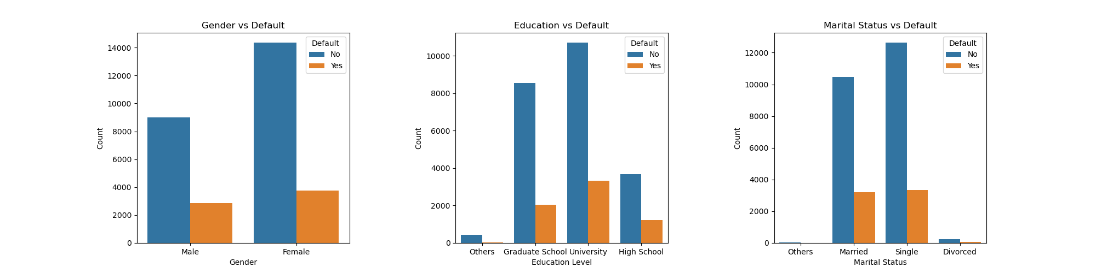
Demographics Analysis
Evaluate how gender, education, and marital status relate to credit default risk.
Gender Dynamics: Identify distinct default patterns between males and females to infer financial management differences.
Educational Impact: Assess the link between education level and financial stability, highlighting default tendencies.
Marital Status Influence: Understand the effect of life stages and marital roles on financial decisions and associated risk.

Slide 6
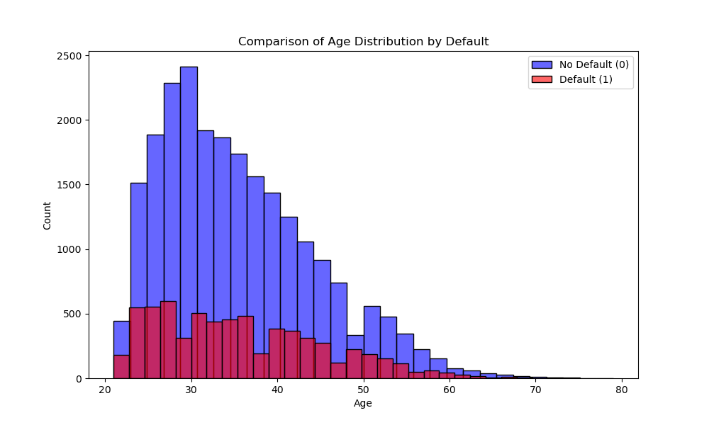
Age Distribution
Age Concentration: Predominant client age range of 20-40 years, peaking in mid-20s to early 30s.
Engagement with Credit: Younger demographics show higher engagement, leading to a larger representation in both default and non-default categories.
Default Patterns: Similar distribution shapes for defaulting and non-defaulting clients, with a notable overlap in younger age groups.
Age-Related Decline in Default: Fewer defaults among older clients, suggesting decreased credit use or lower default risk with age.

Slide 7
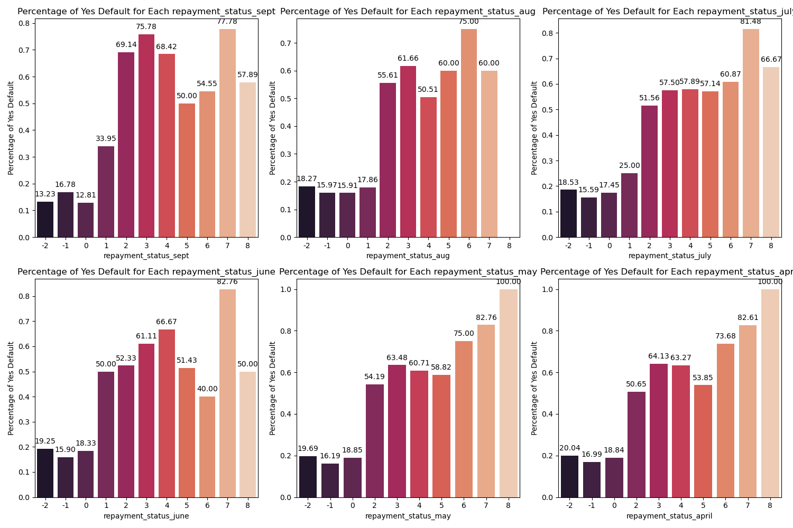
Repayment Status Analysis
Diverse Default Rates: Variability in default rates by repayment status highlights the critical role of payment behavior in risk assessment.
Strategic Risk Management: High default percentages in specific repayment categories necessitate targeted strategies by financial institutions.

Slide 8
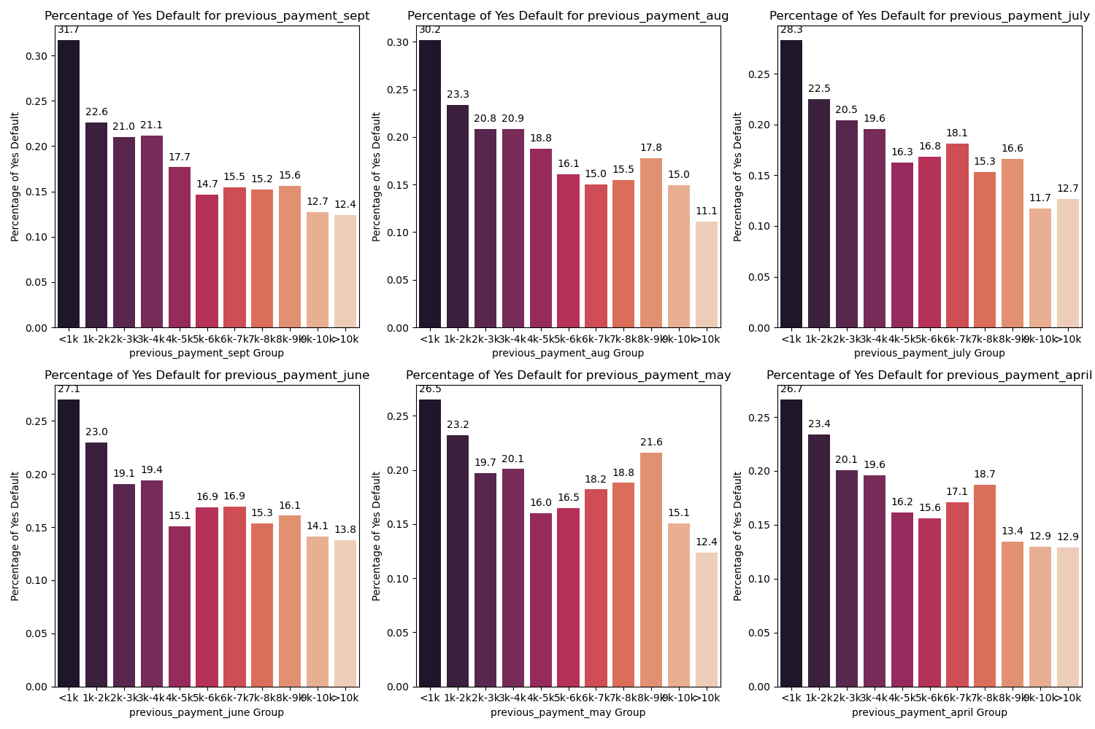
Previous Payments Analysis
Correlation of Payments to Default Rates: Analysis indicates a potential link between the amount of previous payments and the likelihood of default, with lower payments showing more consistent default rates.
Payment History as a Predictor: Persistent patterns suggest that past payment behavior is a significant indicator of financial distress, highlighting its value in credit risk assessment.

Slide 9
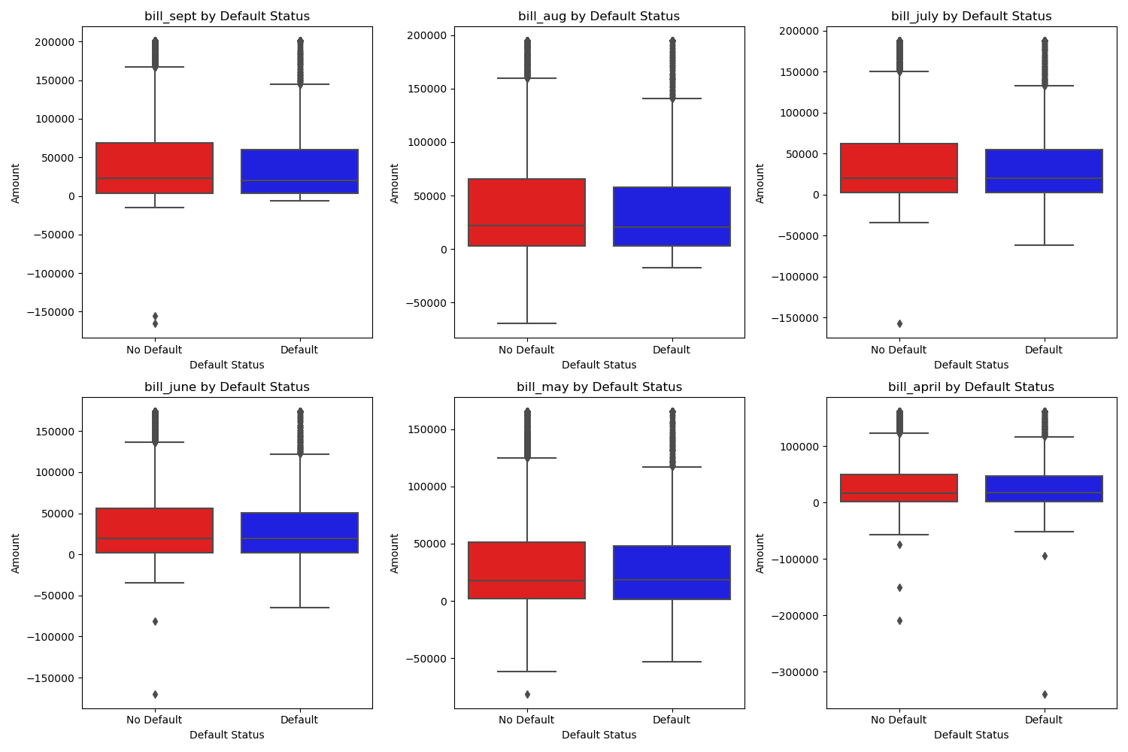
Bill Amount Analysis
The distribution of bill amounts reveals wide variability, indicating that high bill amounts alone may not be a definitive indicator of default risk.

Slide 10
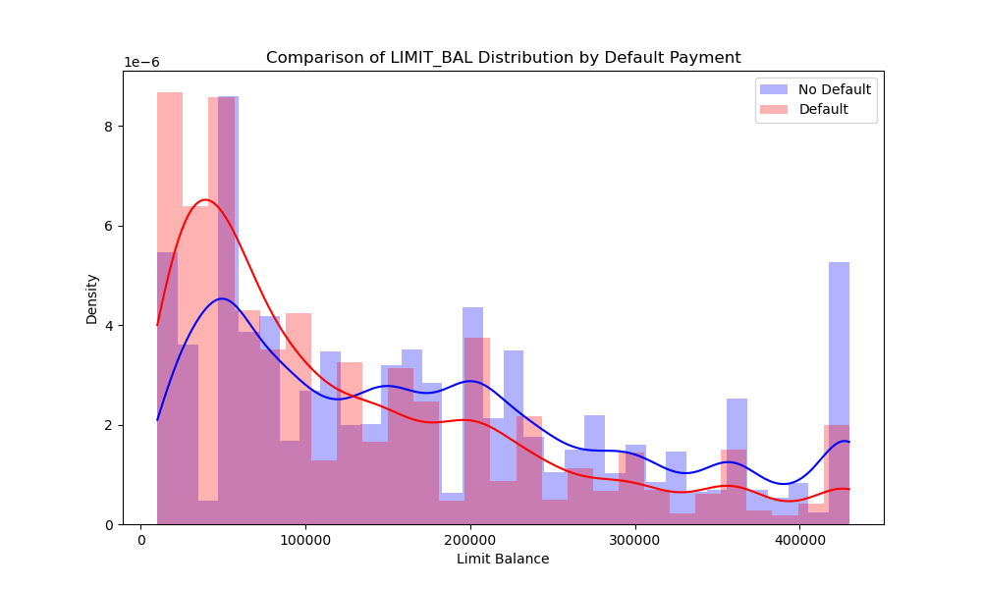
Credit Limit Analysis
Lower credit limits are associated with a higher risk of default, highlighting credit limit as a significant factor in assessing default risk.

Slide 11

Modeling Approach
Various machine learning models were employed to predict credit card default risk, each offering unique insights into the data patterns.
Logistic Regression: Insights into its baseline performance and limitations in capturing complex nonlinear relationships.
Decision Tree and Random Forest: Analysis of their ability to handle nonlinear relationships and the ensemble approach to reduce overfitting.
Gradient Boosting: Highlighting its superior performance, particularly in balancing precision and recall.
Photo by Eduardo Rincon on Unsplash

Slide 12
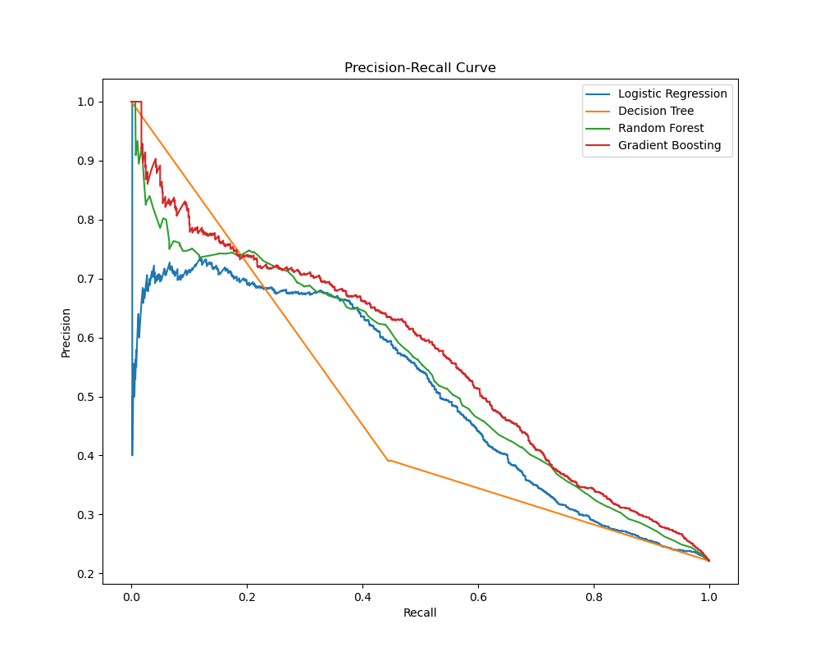
Model Performance
Gradient Boosting and Random Forest emerged as top-performing models, demonstrating superior ability to balance precision and recall.

Slide 13
Key Takeaways
Risk Management: Advanced models offer precise default predictions, enabling proactive risk mitigation and enhancing the institution's financial stability.
Operational Efficiency: Automation of risk assessments streamlines decision-making, optimizing the use of human resources for complex cases.
Financial Performance: Early detection capabilities minimize losses from defaults, identify opportunities for growth, and improve profitability.
Customer Experience: Tailored credit products and early intervention strategies enhance customer satisfaction and loyalty.
Strategic Decision-Making: Data-driven insights from predictive models inform strategic initiatives, promoting market expansion and product innovation.

Slide 14
Future Work
Enhanced Model Accuracy: Continuous data collection and algorithm refinement will lead to more accurate, insightful risk assessments and proactive measures.
Technological Advancements: Integration of AI and machine learning will enable models to adapt in real-time, personalizing risk management strategies.
Innovation in Financial Services: Predictive models will increasingly intersect with broader financial products, offering customers comprehensive management experiences and attracting new clientele with data-driven services.
Adaptability and Compliance: As the financial landscape evolves, these models will provide the agility needed to stay ahead in regulatory and market changes, ensuring responsible credit management practices.

Slide 15
Thanks for your attention

